Slide 1
Topic: Measurement
EQ: How do I convert length measurement?
Get your VIVO’s

Slide 2
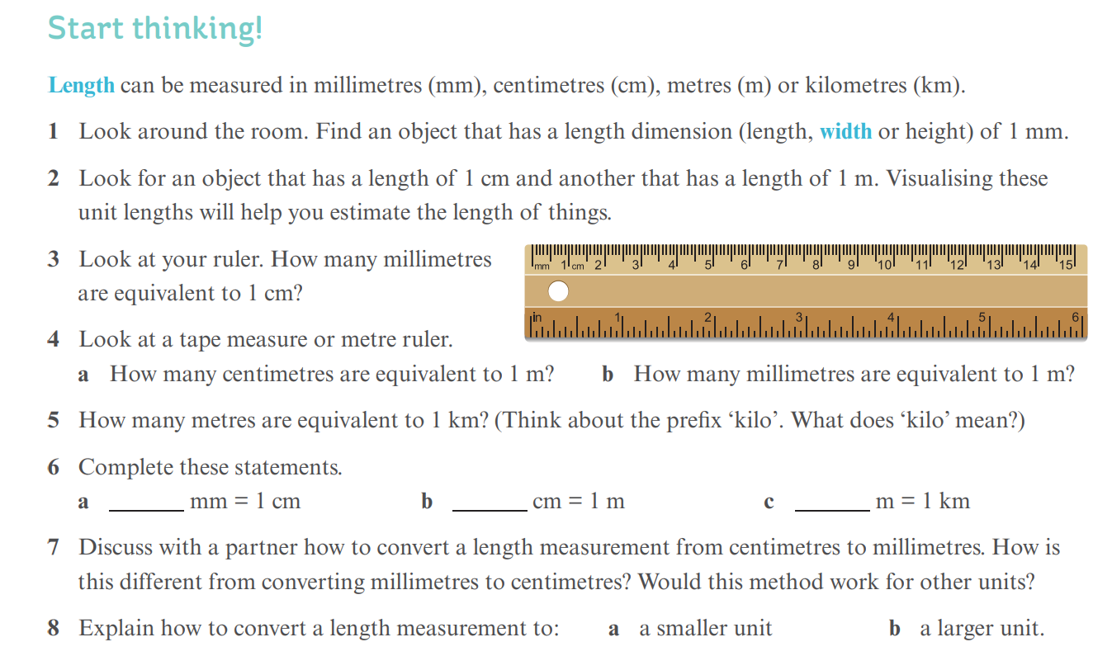
Notes:
Print this slide off for students to brainstorm

Slide 3
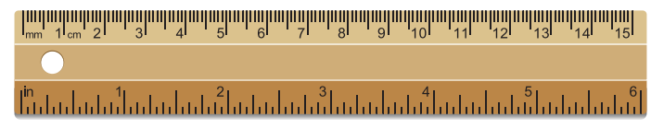
24
7
30
Topic: Measurement
EQ: How do I convert length measurement?
Start thinking
Look around the room. Find an object that has a length dimension (length, width or height) of 1 mm.
2. Look for an object that has a length of 1 cm and another that has a length of 1 m.
Visualising these unit lengths will help you estimate the length of things.
3. Look at your ruler. How many millimetres are equivalent to 1 cm?
4. Look at a tape measure or metre ruler.
How many centimetres are equivalent to 1 m?
How many millimetres are equivalent to 1 m?
5. How many metres are equivalent to 1 km? (Think about the prefix ‘kilo’. What does ‘kilo’ mean?)

Slide 4
24
7
30
Topic: Measurement
EQ: How do I convert length measurement?
Start thinking
5. How many metres are equivalent to 1 km? (Think about the prefi x ‘kilo’. What does ‘kilo’ mean?)
6. Complete these statements.
____mm = 1 cm
____cm = 1 m
____m = 1 km
7. Discuss with a partner how to convert a length measurement from centimetres to millimetres. How is this different from converting millimetres to centimetres? Would this method work for other units?
8. Explain how to convert a length measurement to:
a )a smaller unit b) a larger unit.

Slide 5
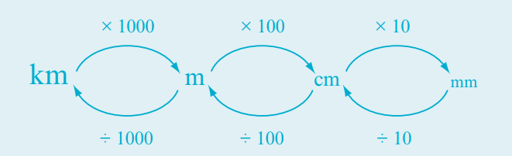
24
7
30
Topic: Measurement
EQ: How do I convert length measurement?
______________________________________?
Metric units of length are millimetres (mm), centimetres (cm), metres (m) and kilometres (km).
A unit of length can be converted to another unit of length by multiplying or dividing by the conversion factor.
________________ by the conversion factor to convert to a smaller unit.
________________ by the conversion factor to convert to a larger unit
______________________________________?
Notes:
Students need to practice developing the questions

Slide 6
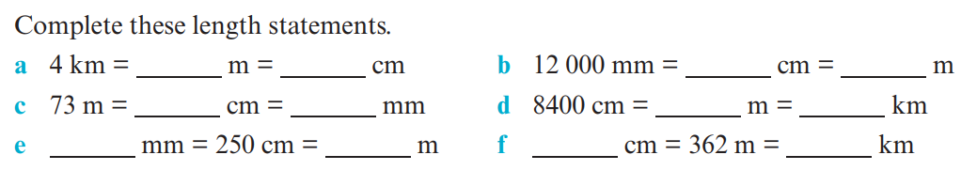
Practice Question 1:
Practice Question 2:
The length of a swimming pool is 50 m.
How far would you swim if you completed 25 laps?
Would this distance be more or less than 1 km?
How many laps would you swim to complete a distance of 2 km?
Practice Question 3:
Some students made errors when they were converting some length measurements. Explain the error in each case and give the correct answer.
a)55 cm = 5.5 mm
b)24 km = 2400 m

